Slide 1


Slide 2


Slide 3
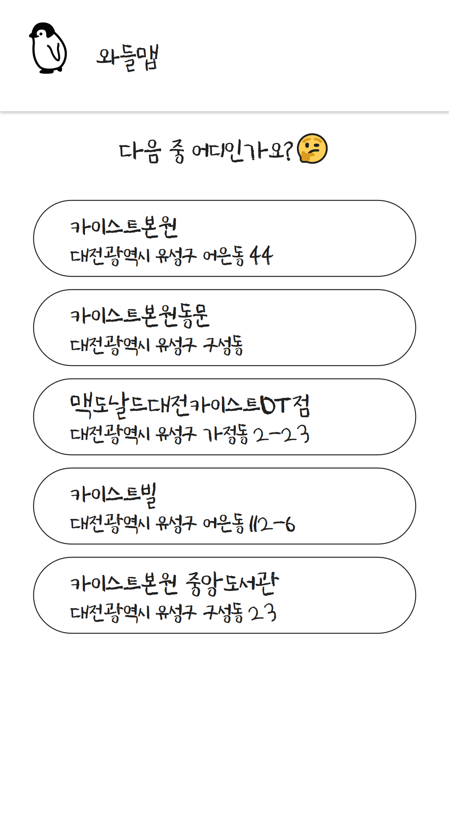

Slide 4


Slide 5
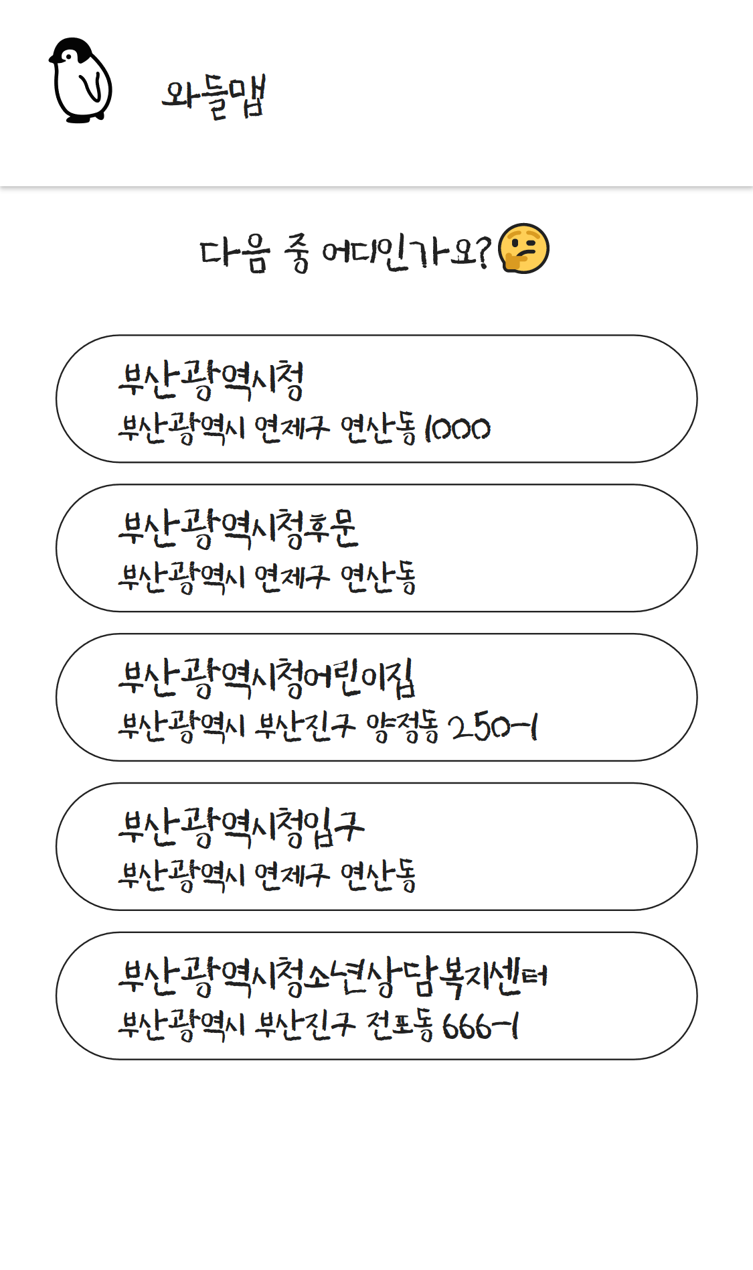

Slide 7
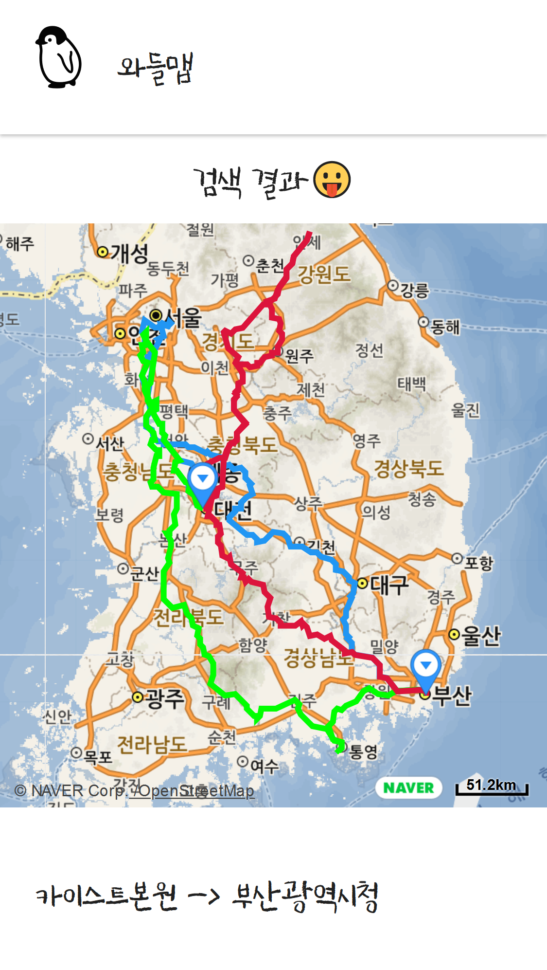

Slide 9

https://github.com/waddlecorp/Waddle-Map

